Slide 1
Cat Scratch Fever
Assist. Prof. Dr. Hussein ALNaji

Slide 2
Cat scratch fever (cat scratch disease) is an uncommon bacterial infection you can get from a cat scratch or bite. Fleas infect cats with the bacteria that cause cat scratch disease (Bartonella henselae ).

Slide 3
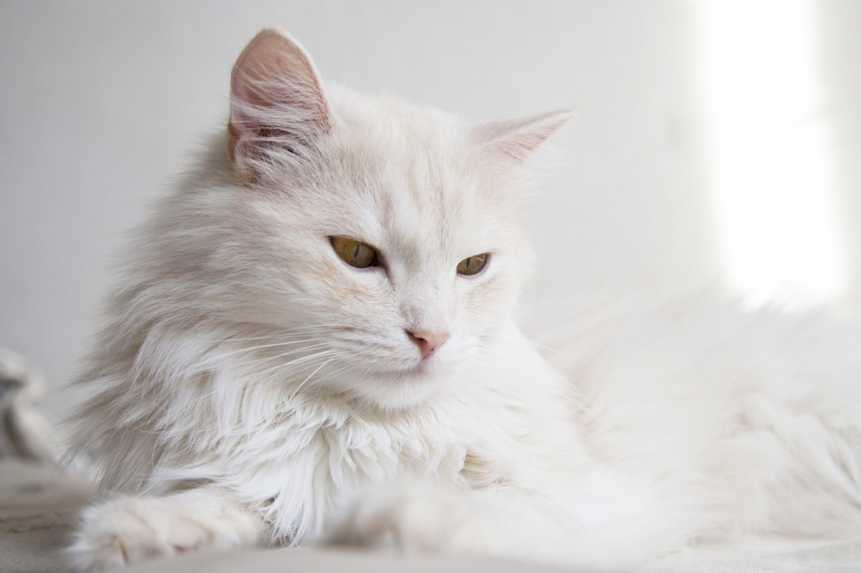
Cat-scratch disease is infection caused by the gram-negative bacteria Bartonella henselae and transmitted by a scratch or bite from an infected cat, often causing a crusted bump and swollen lymph nodes.
Some evidence suggests that CSD may be spread directly to people by the bite of infected cat fleas, although this has not been proven.

Slide 4
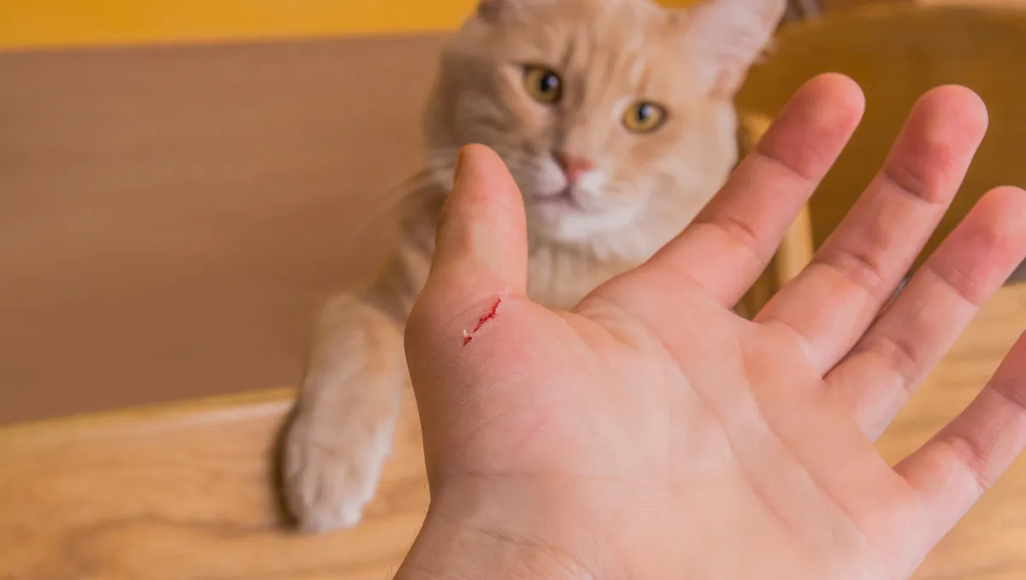
Symptoms of Cat-Scratch Disease
1- At the site of a cat bite or scratch, a red, painless bump develops within about 3 to 10 days.
2-The bump usually has a crust and sometimes contains pus.
3- Within 2 weeks (sometimes after the scratch has healed), nearby lymph nodes swell and become tender and filled with pus.
4- People may have a fever, headache, and poor appetite.
5- Sometimes pus drains from the swollen lymph nodes.

Slide 5
Diagnosis of Cat-Scratch Disease
1- Blood tests
2- Sometimes blood culture
3- Sometimes lymph node fluid aspiration or biopsy
4- To diagnose cat-scratch disease, doctors measure antibodies to the
5- ELISA test
6- Polymerase chain reaction (PCR) technique.

Slide 6
Treatment
1- For people in good health, CSD will likely go away without treatment.
2- Anti-inflammatory medicine like ibuprofen or naproxen
3- A hot compress can help, too.
4- To relieve very tight, painful glands, your doctor may gently insert a needle into them and drain the fluid.

Slide 7
Prevention
To reduce your risk of getting CSD:
Keep the cat indoors.
Avoid cat scratches, bites, and licks. Declawing is not recommended to prevent CSD.
Promptly wash any cat scratches or bites with soap and water.
Avoid contact with fleas.
Treat your cat with a flea control product recommended by your veterinarian.
If you are getting a cat, make sure it’s at least a year old, in good health, and free of fleas. Avoid and do not adopt stray cats or cats with flea infestations.

Slide 8
Thank you

